Slide 1
Data Science: Concepts and Practice
Course slides

Slide 2
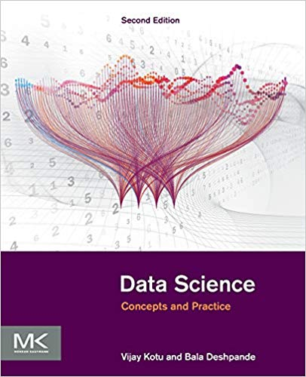

Course Software
Course Book
Data Science: Concepts and Practice
Authors : Vijay Kotu & Bala Deshpande
Publisher : Morgan Kaufmann
www.rapidminer.com
Free Download

Slide 3
Introduction

Slide 4
What is …?
AI
ML
Big data
Data Science

Slide 5
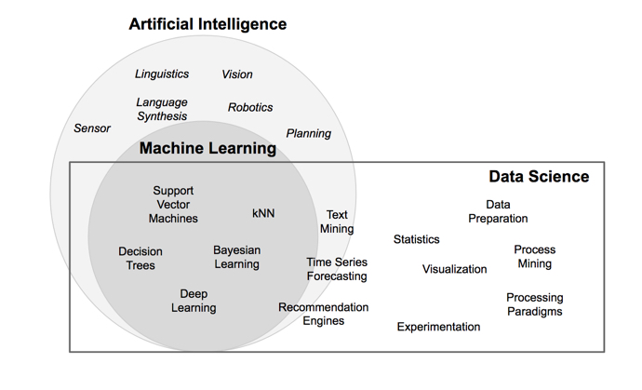
What is Data Science

Slide 6
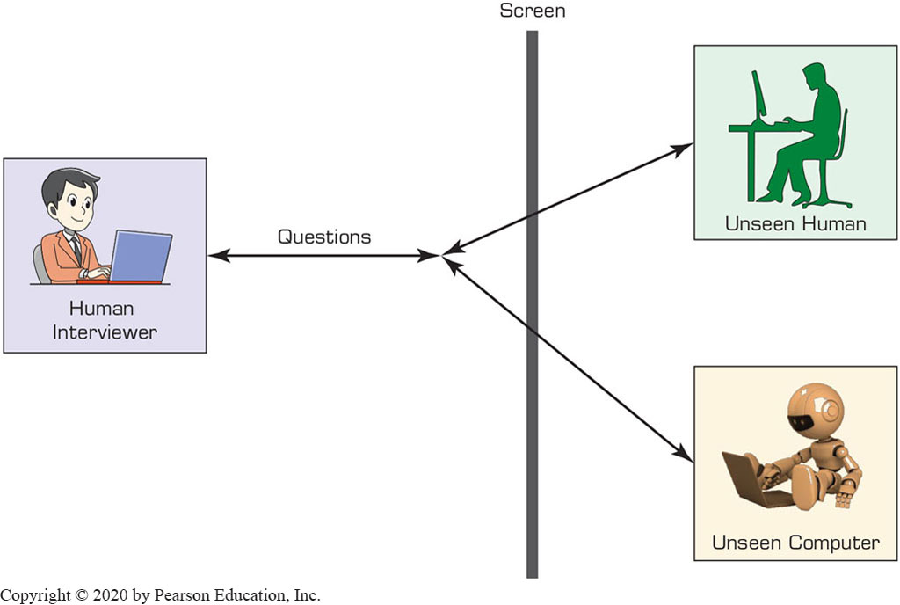
Human and Computer Intelligence
Measuring A I: The Turing Test

Slide 7
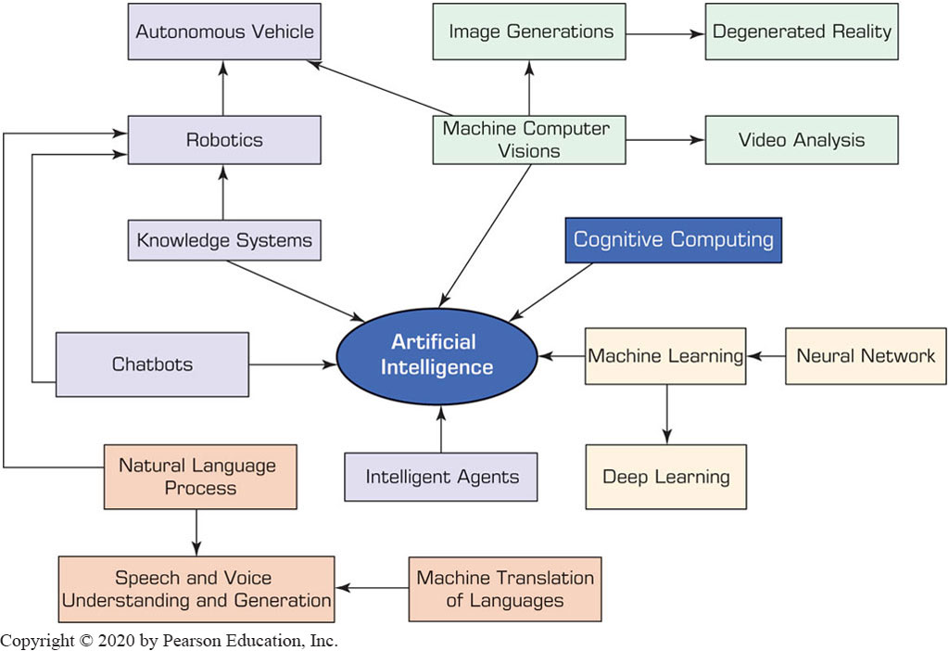
Major A I Technologies

Slide 8
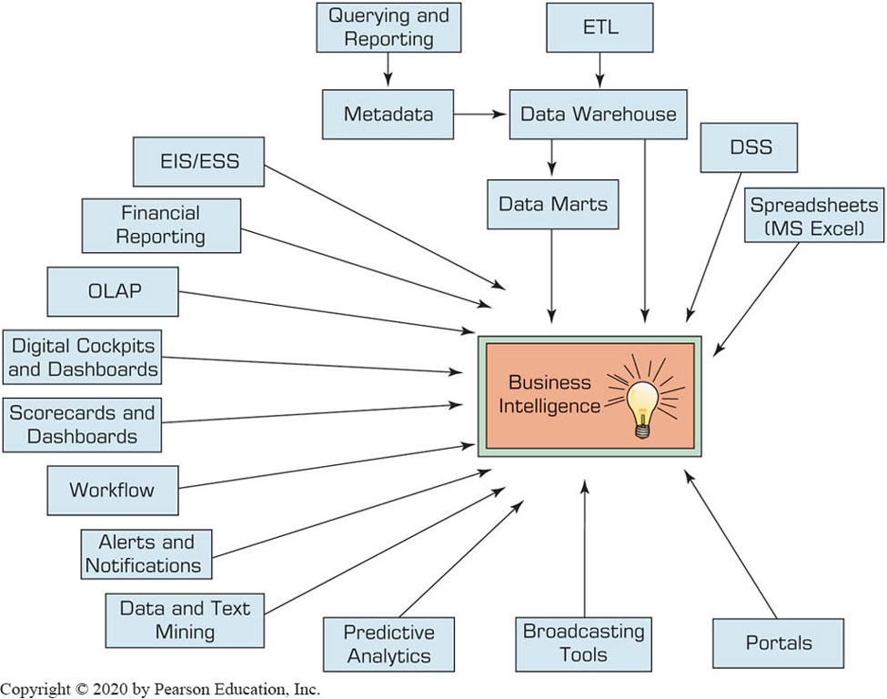
Evolution of Business Intelligence (B I)

Slide 9
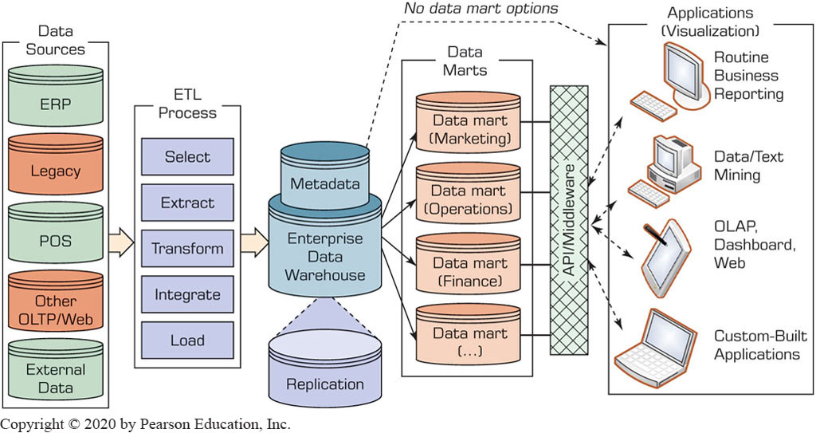
Data Warehouse Framework

Slide 10
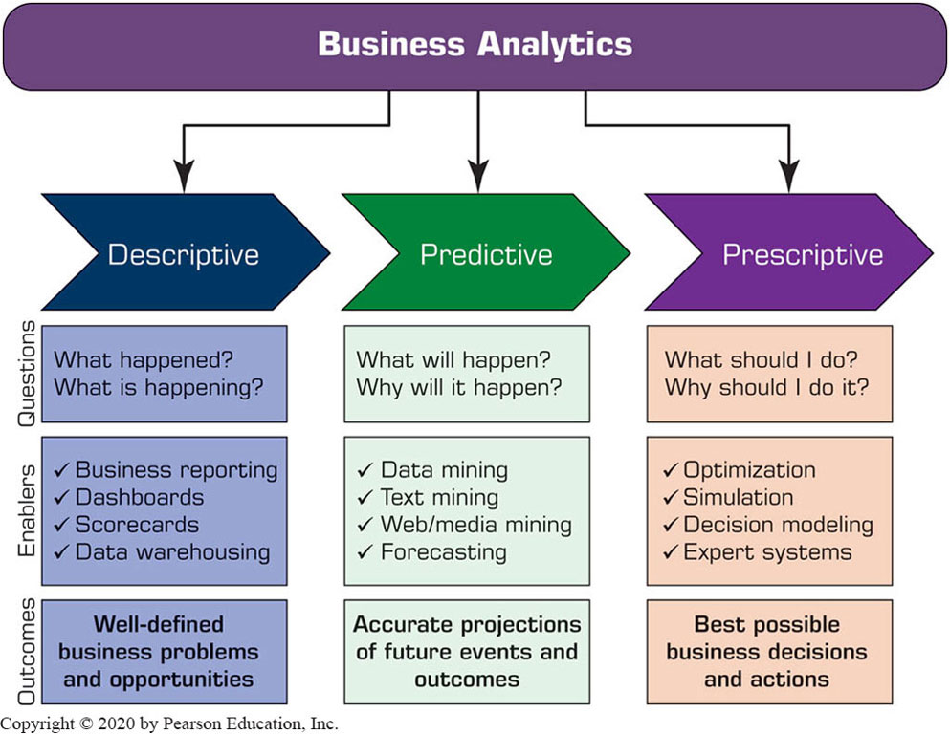
Analytics Overview

Slide 11
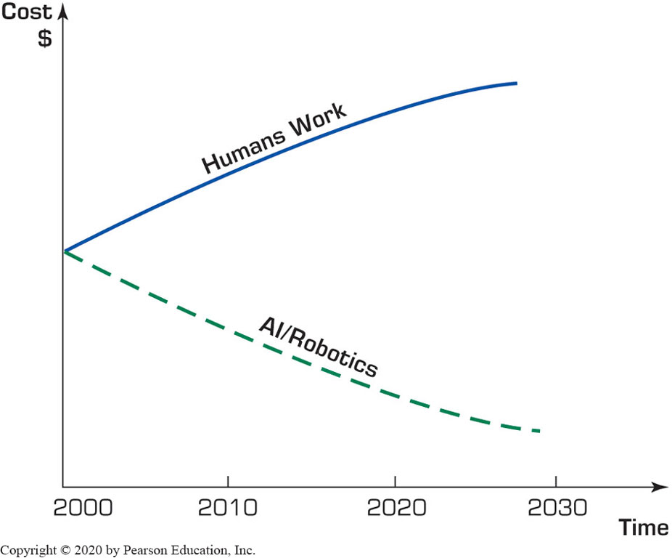
Artificial Intelligence (A I)
Figure 2.2 Cost of Human Work versus the Cost of A I Work.

Slide 12
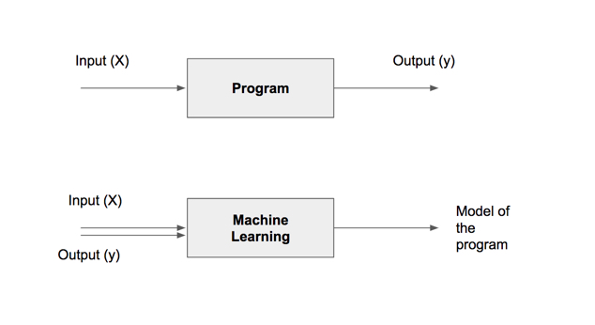
Models

Slide 13
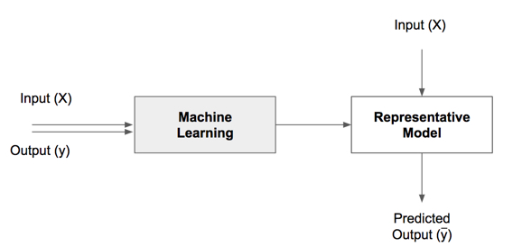
Using Models

Slide 14
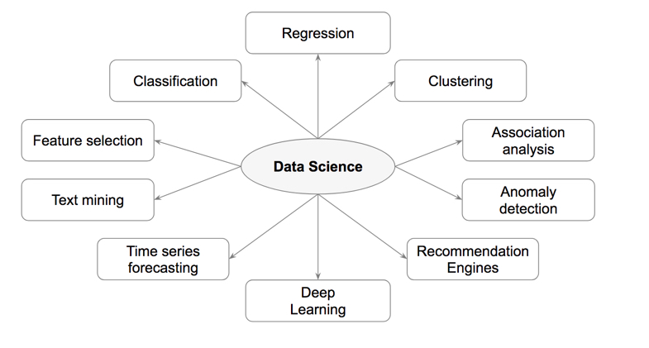
Types of Data Science

Slide 15
Tasks | Description | Algorithms | Examples
Classification | Predict if a data point belongs to one of predefined classes. The prediction will be based on learning from known data set. | Decision Trees, Neural networks, Bayesian models, Induction rules, K nearest neighbors | Assigning voters into known buckets by political parties eg: soccer moms. Bucketing new customers into one of known customer groups.
Regression | Predict the numeric target label of a data point. The prediction will be based on learning from known data set. | Linear regression, Logistic regression | Predicting unemployment rate for next year. Estimating insurance premium.
Anomaly detection | Predict if a data point is an outlier compared to other data points in the data set. | Distance based, Density based, LOF | Fraud transaction detection in credit cards. Network intrusion detection.
Time series | Predict if the value of the target variable for future time frame based on history values. | Exponential smoothing, ARIMA, regression | Sales forecasting, production forecasting, virtually any growth phenomenon that needs to be extrapolated
Clustering | Identify natural clusters within the data set based on inherit properties within the data set. | K means, density based clustering - DBSCAN | Finding customer segments in a company based on transaction, web and customer call data.
Association analysis | Identify relationships within an itemset based on transaction data. | FP Growth, Apriori | Find cross selling opportunities for a retailor based on transaction purchase history.

Slide 16
Course
outline
Core Algorithms
Classification
Decision Trees
Rule Induction
k-Nearest Neighbors
Naïve Bayesian
Artificial Neural Networks
Support Vector Machines
Ensemble Learners
Regression
Linear Regression
Logistic Regression
Association Analysis
Apriori
FP-Growth
Clustering
k-Means
DBSCAN
Self-Organizing Maps
Process Basics
Common Applications
Data Science Process
Data Exploration
Model Evaluation
Text Mining
Time Series Forecasting
Anomaly Detection
Feature Selection

